Slide 1
Computing Research Project for including Digitalization in Remote working System
Module Project
Module: Computing Research Project
Course: : Computing Research Project by doing digitalization for Remote Workers in Business .
Start Date : 28/11/2023
End Date : 21/12/2023
Submission Date: 17/01/2024
Learner Name: Nithika Minlaka Jayarathne
Enrollment ID: JISC – LS05422
Presentation Date:31/01/2024

Slide 2
Document History
Version Number | Effective Date of release | Summary of Included Changes | Author
1 | 6th August 2021 | First Edition | Student Name

Slide 3

1. Project Definition
Project Background: brief out the scenario
Jumpstart is a retail enterprise that operates 750 sites around the country. Their items are innovative and of great quality, which draws in customers. A substitute norm of remote employment has arisen in the post-Covid 19 era, which is causing numerous disruptions to their main business. They ought to alter their business plan to put the needs of the client first. To fix the problems, Aceadora Tech was contacted by Jumpstart's Chief Operations Manager. A corresponding e-commerce website was made there. In other words, software developers working on the capstone project designed a project for the JumpStart retail shop while taking into account the expertise needed for project planning, research, design, and implementation. I've chosen to discuss the most important clothing items that any woman, man, and child needs to have here. Jumpstart made a website to serve as an online clothes store in order to do that. Products, their details, carts, checkout, and products can all be posted and ordered there. Additionally, this website was made with the user and admin in mind, allowing them to modify the relevant facts.
Project Goal:
Increasing traffic from social media.
Creating More Compelling Content.
Better Use of Email Marketing.
Improved Shopping Cart Abandonment Rates.
Increased Conversion Rates.
Increased Customer Satisfaction.
Improved Retention/Loyalty Among Customers.

Slide 4

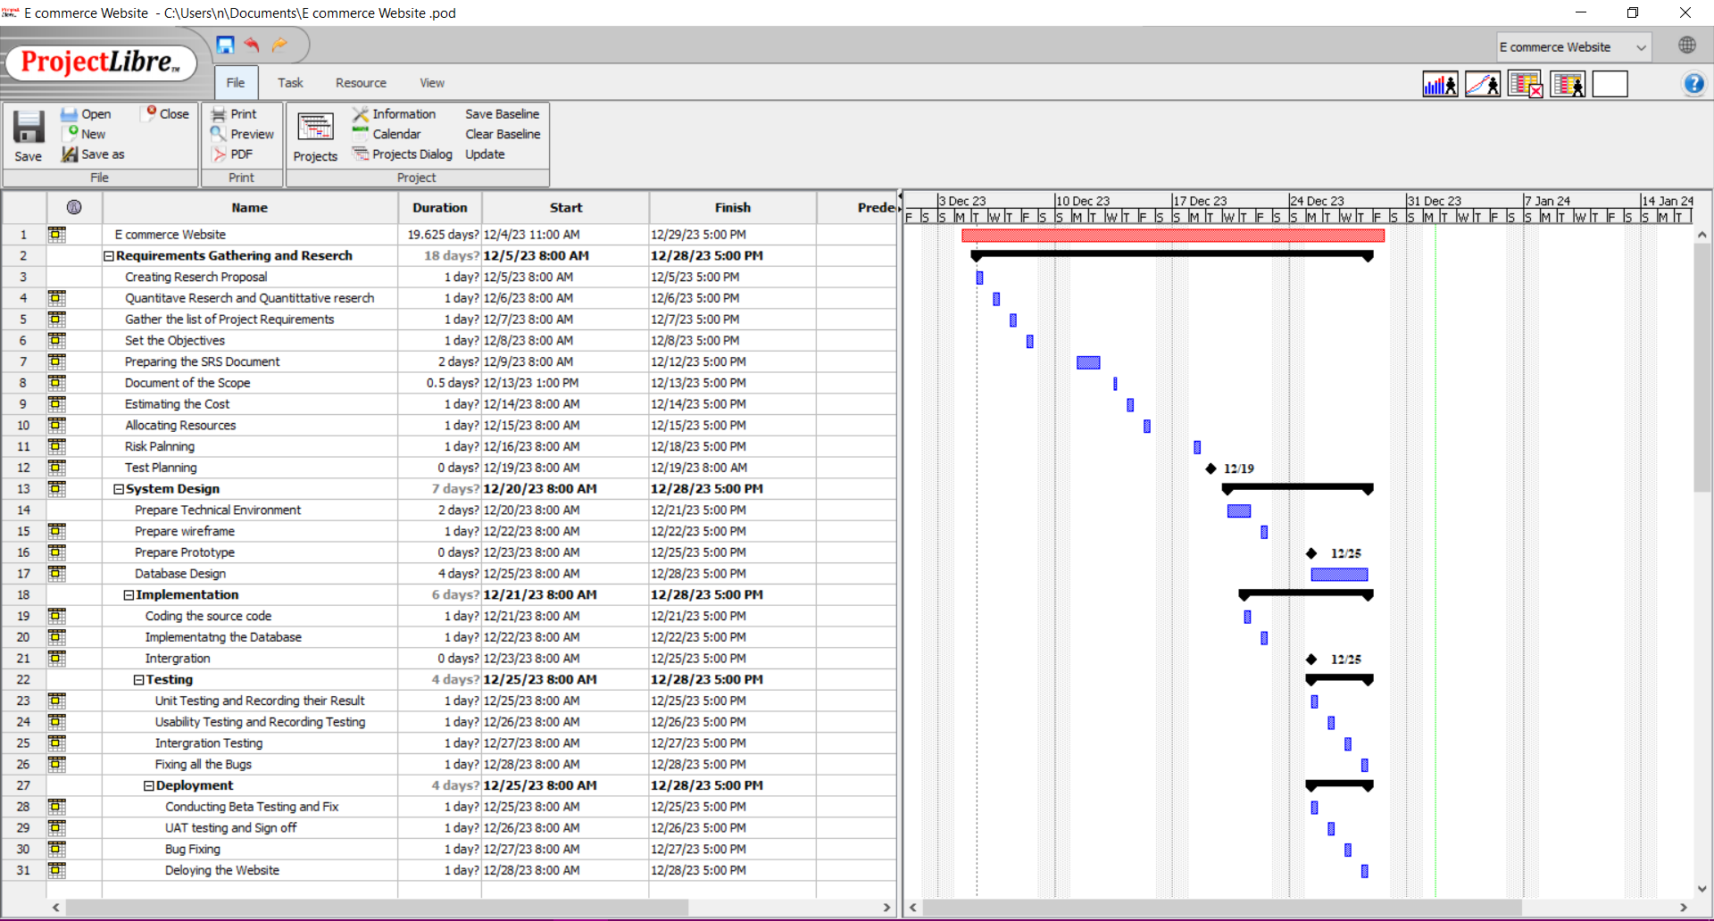
2. Project Deliverables
Project Deliverables:
Project Plan

Slide 5
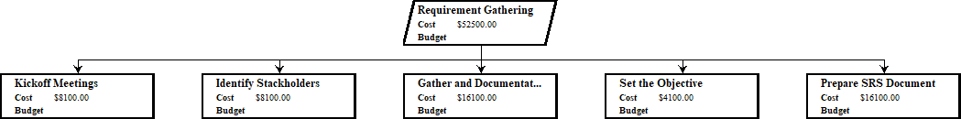
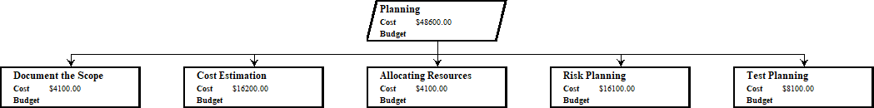
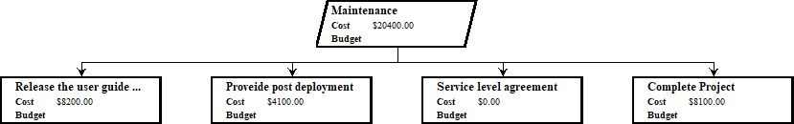
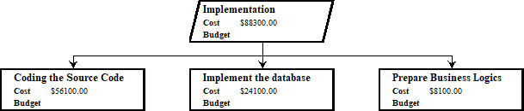
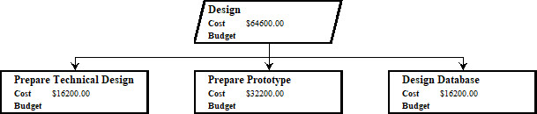
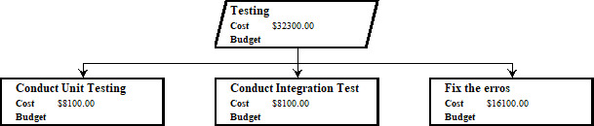
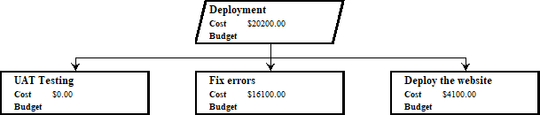
2. Project Deliverables
Project Deliverables: WBS
2
3
4
7
5

Slide 6
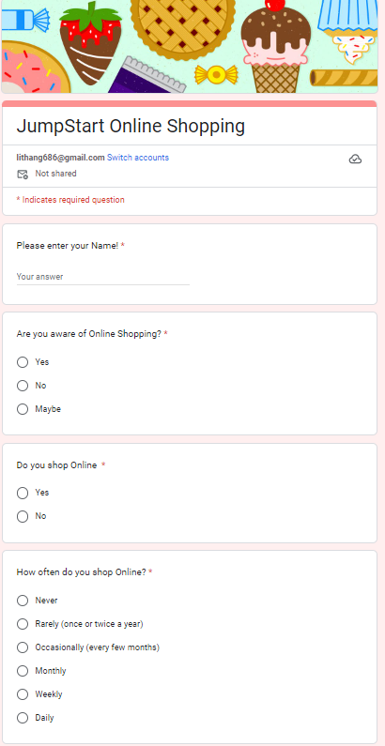
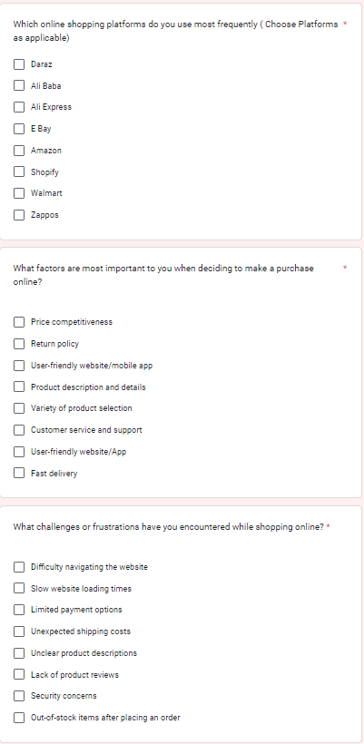
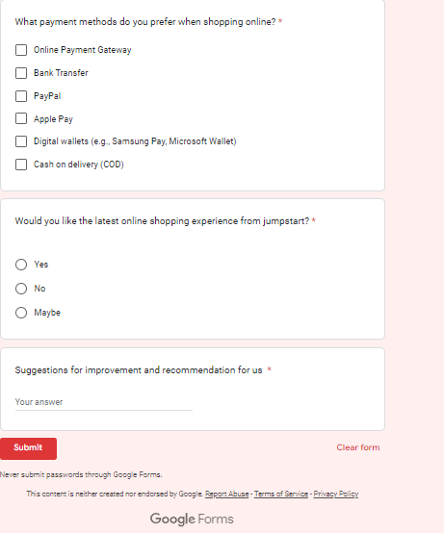
2. Project Deliverables
Project Deliverables:
Pre Implementation Survey
https://forms.gle/3SESfstjbvSc4z8F8

Slide 7
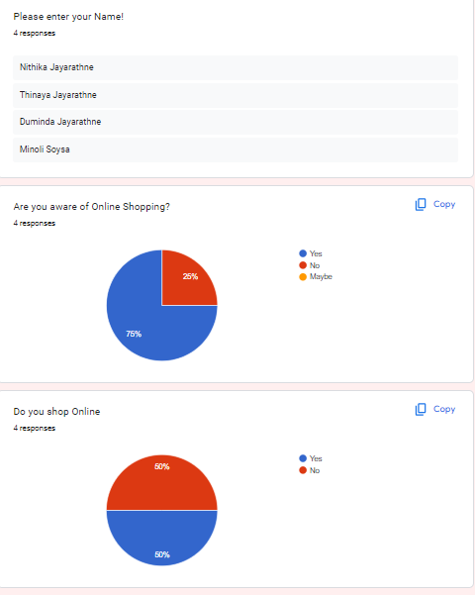
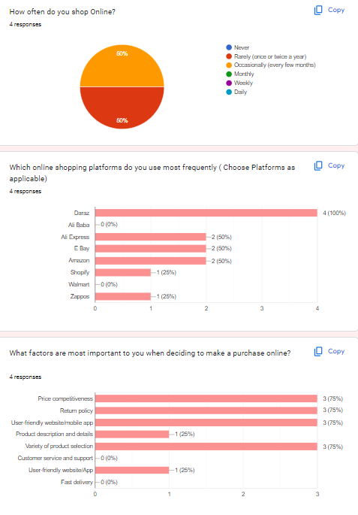
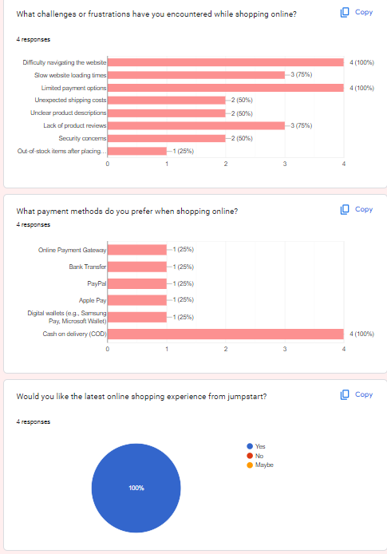
2. Project Deliverables
Project Deliverables:
Pre Implementation Survey - Responses

Slide 8
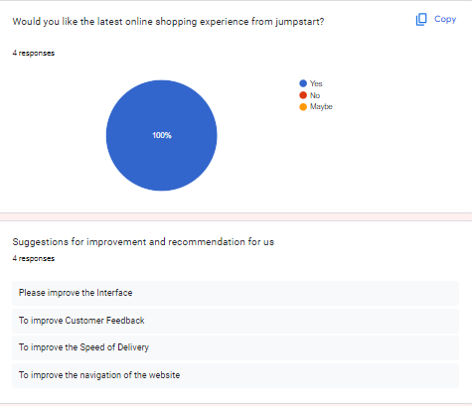
2. Project Deliverables
Project Deliverables:
Pre Implementation Survey - Responses

Slide 9
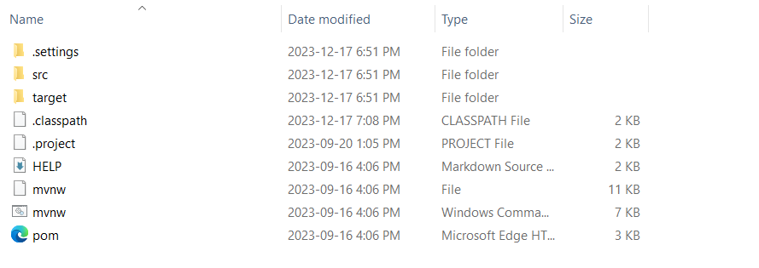
2. Project Deliverables
List of Evidences
Screenshots of the project directory

Slide 10
3. Project Milestones & Tasks
Project Task ID | Project Task Description | Project Milestone ID
1 | Conduct Survey For information Gathering | 1
2 | Prepare Research Proposal template | 1
3 | Prepare Work Breakdown Structure | 1
4 | Create Gantt Chart using Project Libre | 2
5 | Compare and Evaluate Project Solution by doing Research | 2
6 | Conduct Survey for Jumpstart Opinion on Recommended Solution | 2
7 | Setup the Development Environment based on the Technical Development Environment | 2
8 | Project Report detailing the Technical Design | 3
9 | Develop the UI standard pages | 3
10 | Create common Struts Includes, Models, Views & Controllers | 3
11 | Develop Classes | 3
12 | Develop Test Cases | 3
13 | Develop Project Documentation | 3
14 | Develop User Manual | 3

Slide 11
4. Project Environment
Technical Environment and Tools Used
Spring Tool Suite (STS) 3
MySQL Workbench 8.0 CE
Axure RP 10
Project Libre
Draw.io
Microsoft Word
Microsot PowerPoint
Microsoft Excel
Google Form
List of references
https://dist.springsource.com/release/STS/index.html
https://dev.mysql.com/downloads/workbench/
https://www.axure.com/download
https://sourceforge.net/projects/projectlibre/
Login.png - diagrams.net
https://forms.gle/ahhb2n9TA6jnwyVC9

Slide 12


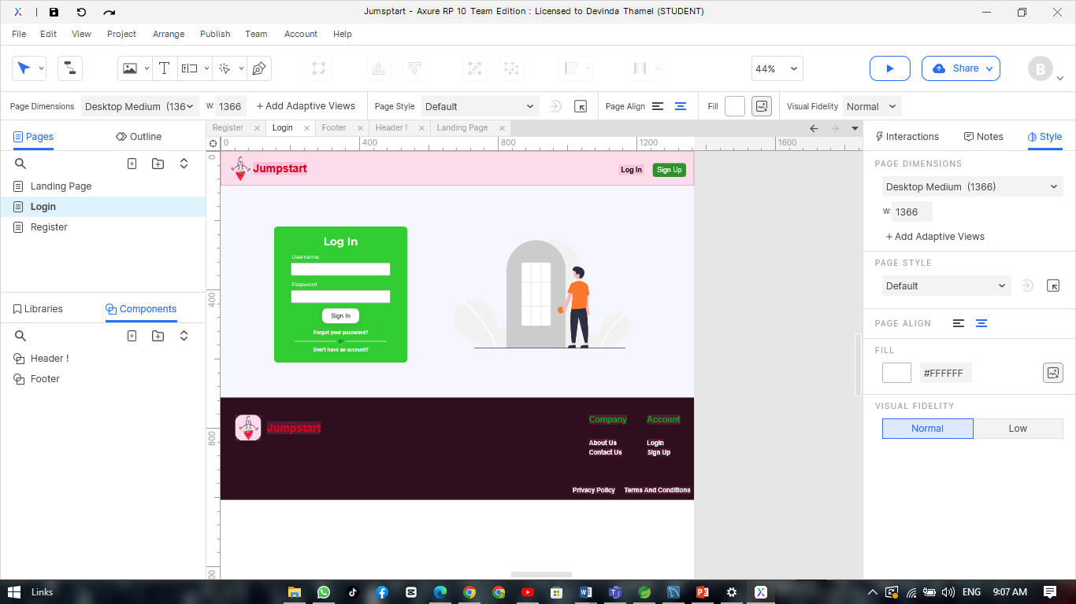


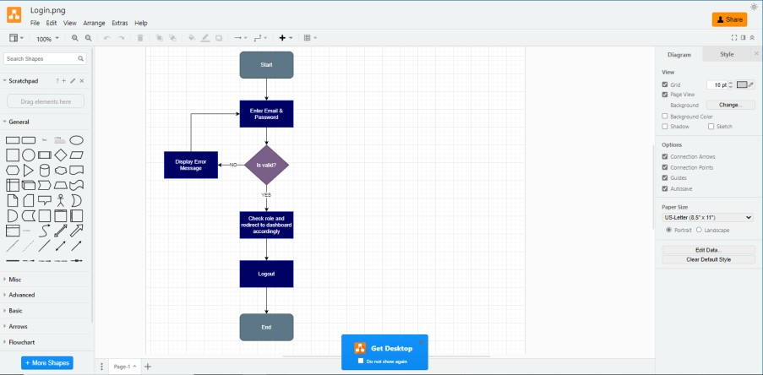
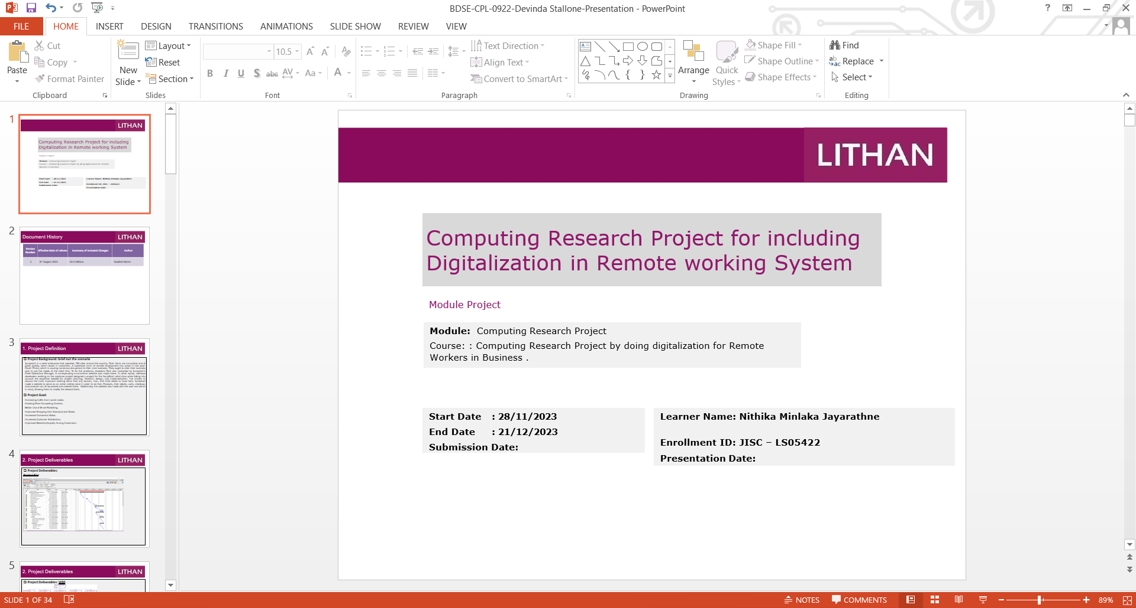
5. Tools
Tools & Platforms Used
Axure
Project Libre
Diagram.net
Microsoft Power Point

Slide 13


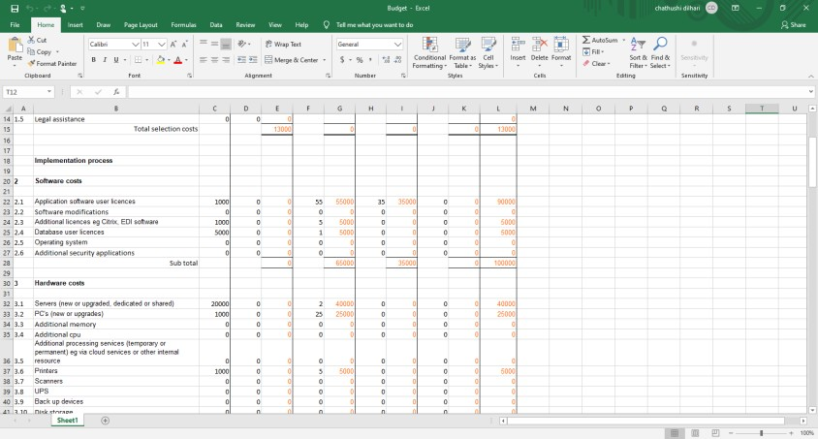
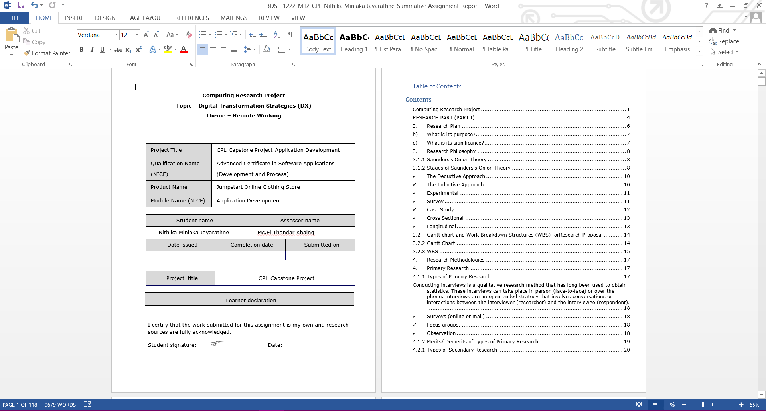


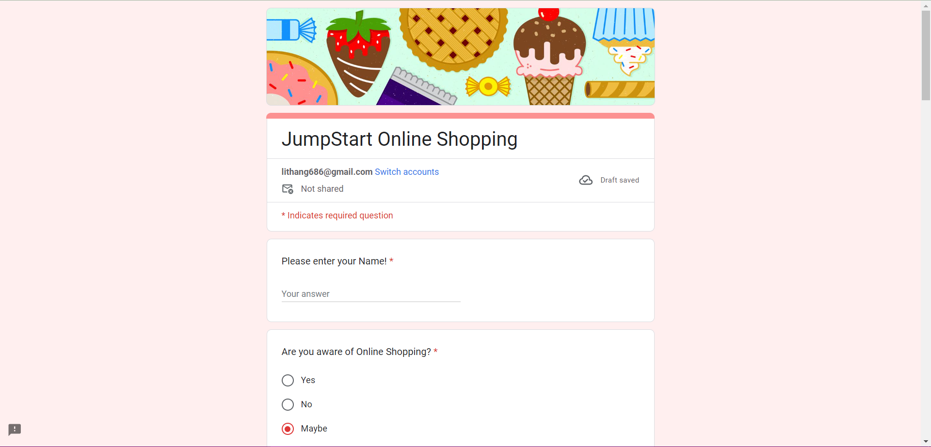
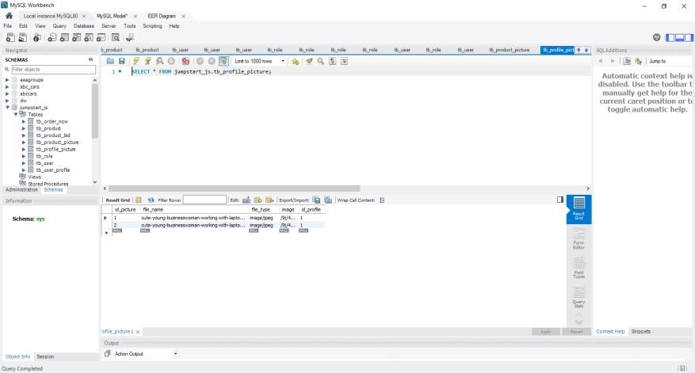
5. Tools
Tools & Platforms Used
Microsoft Word
Microsoft Excel
Google Form
MySQL Workbench

Slide 14

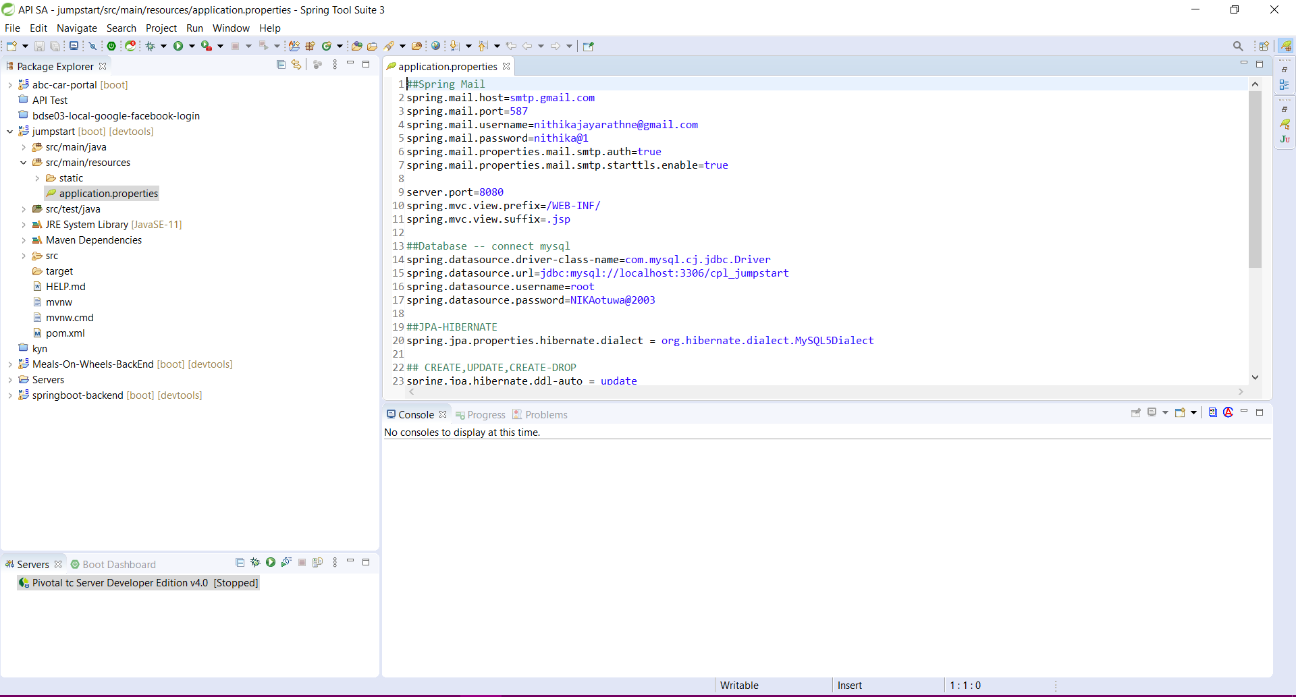
5. Tools
Tools & Platforms Used
STS

Slide 15
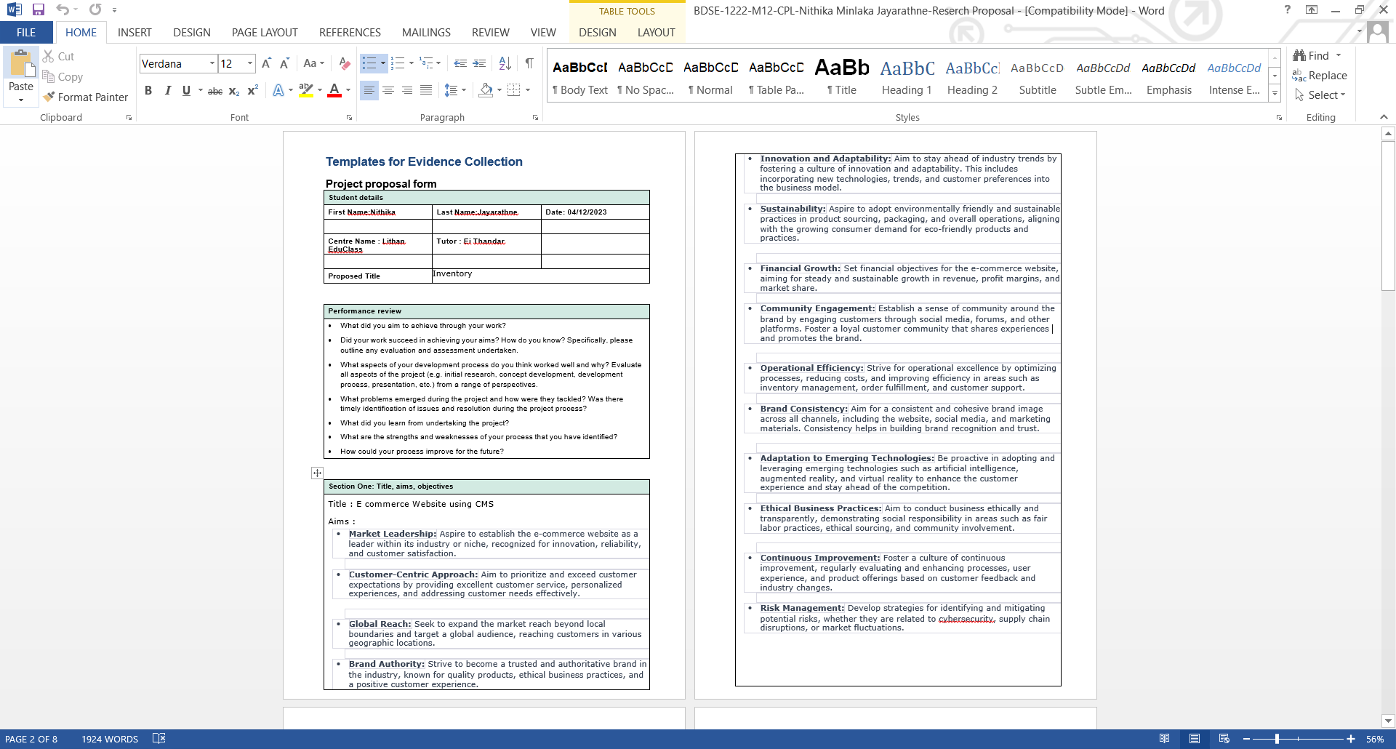
6. Research Proposal Template
2

Slide 16
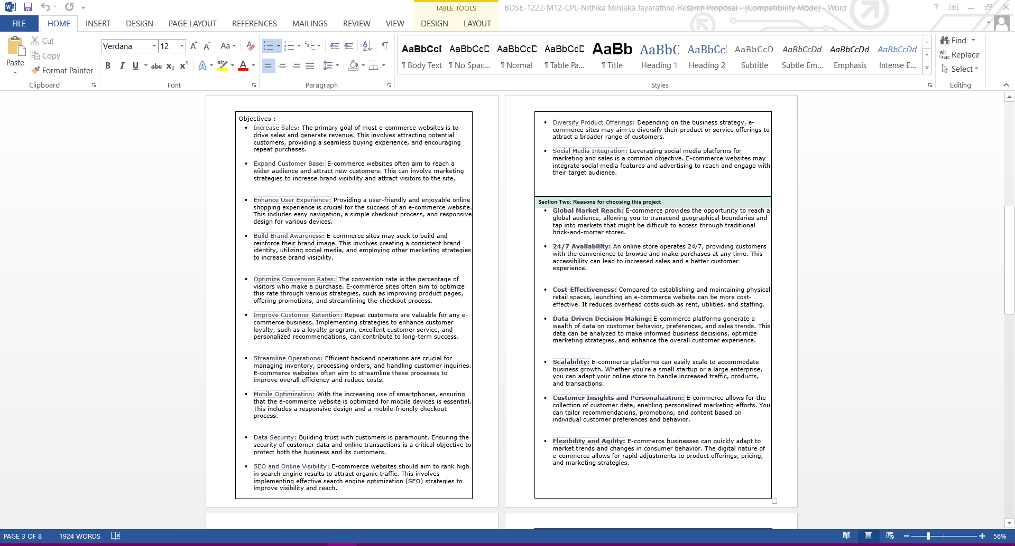
6. Research Proposal Template

Slide 17
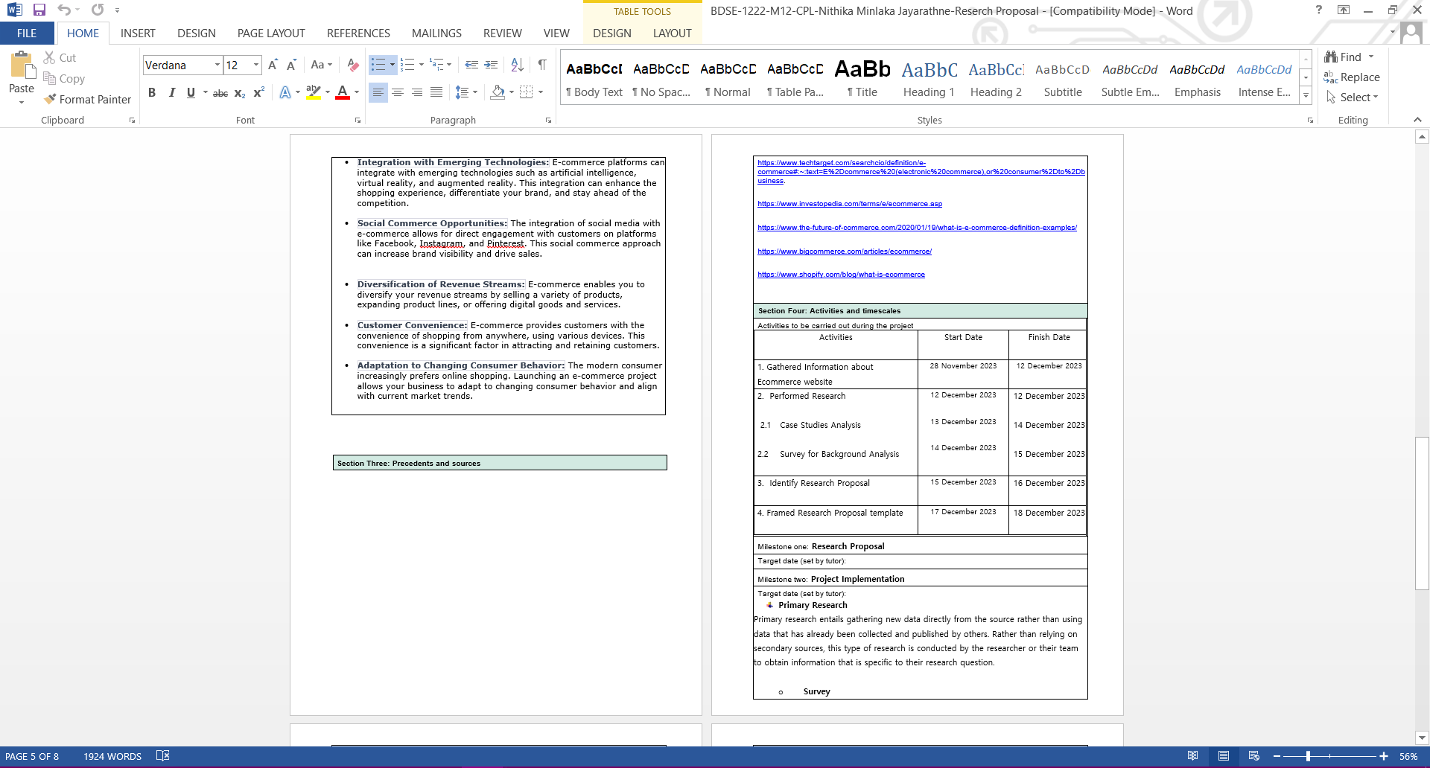
6. Research Proposal Template

Slide 18
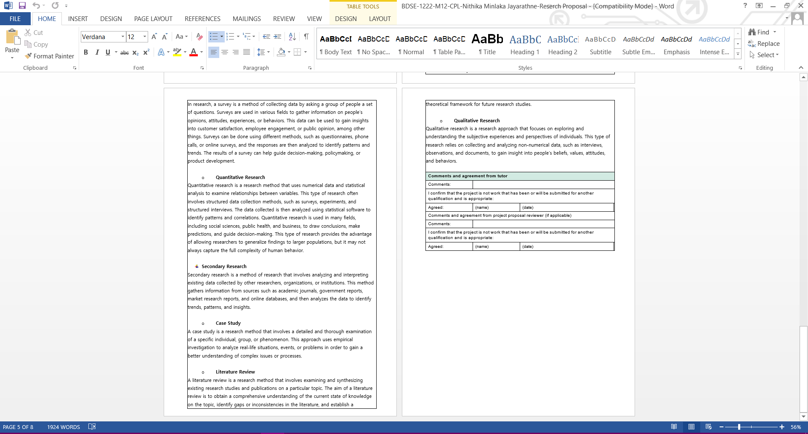
6. Research Proposal Template

Slide 19
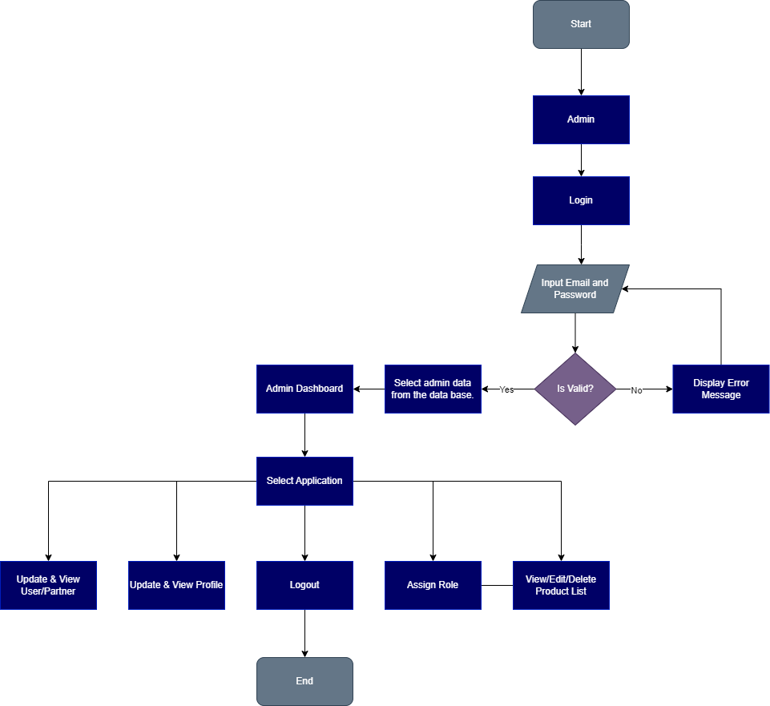
7. Project Design
Project Flowchart:
Admin

Slide 20
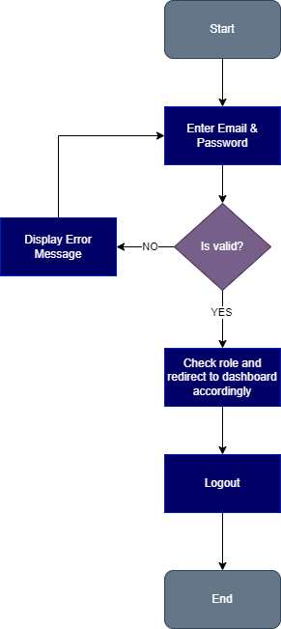
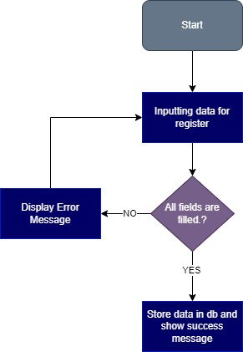
7. Project Design
Project Flowchart:
Login
Registration

Slide 21
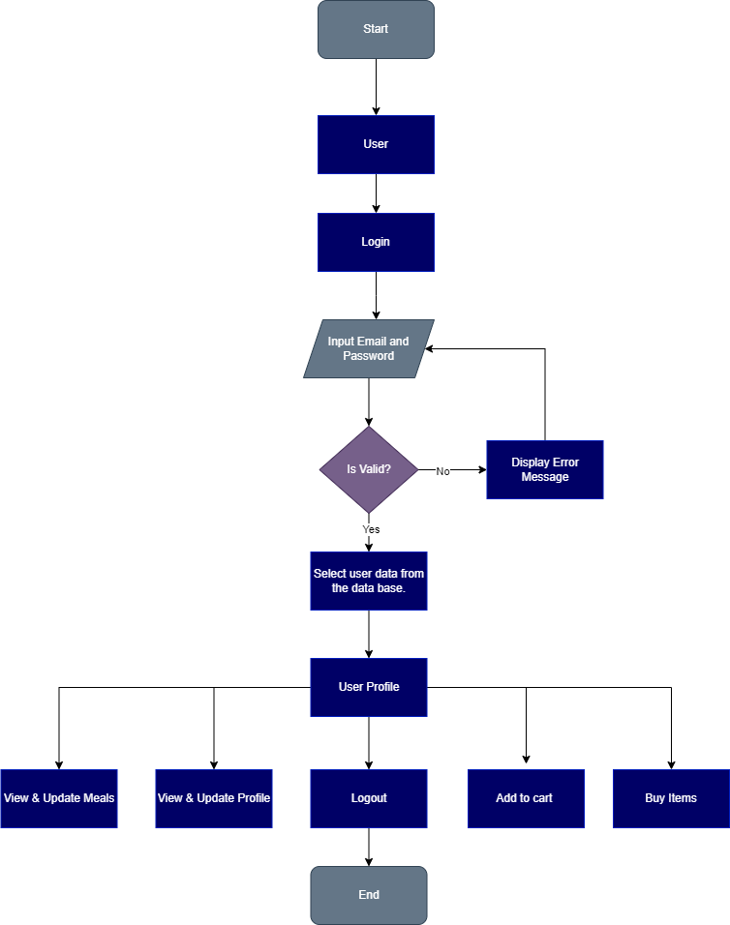
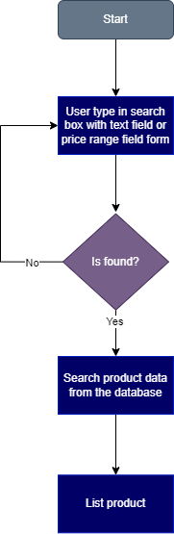
7. Project Design
Project Flowchart:
User
Search Products

Slide 22
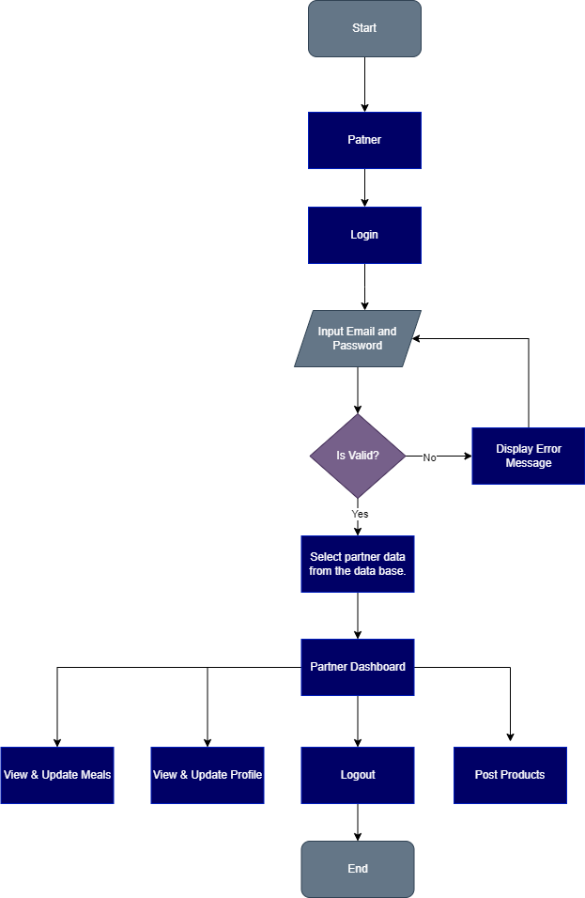
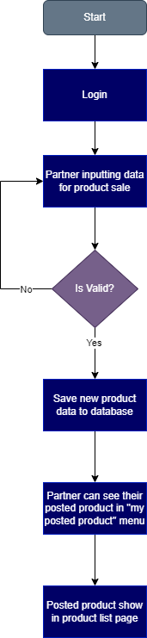
7. Project Design
Project Flowchart:
Partner
Post Products

Slide 23
8. Project Gantt Chart

Slide 24
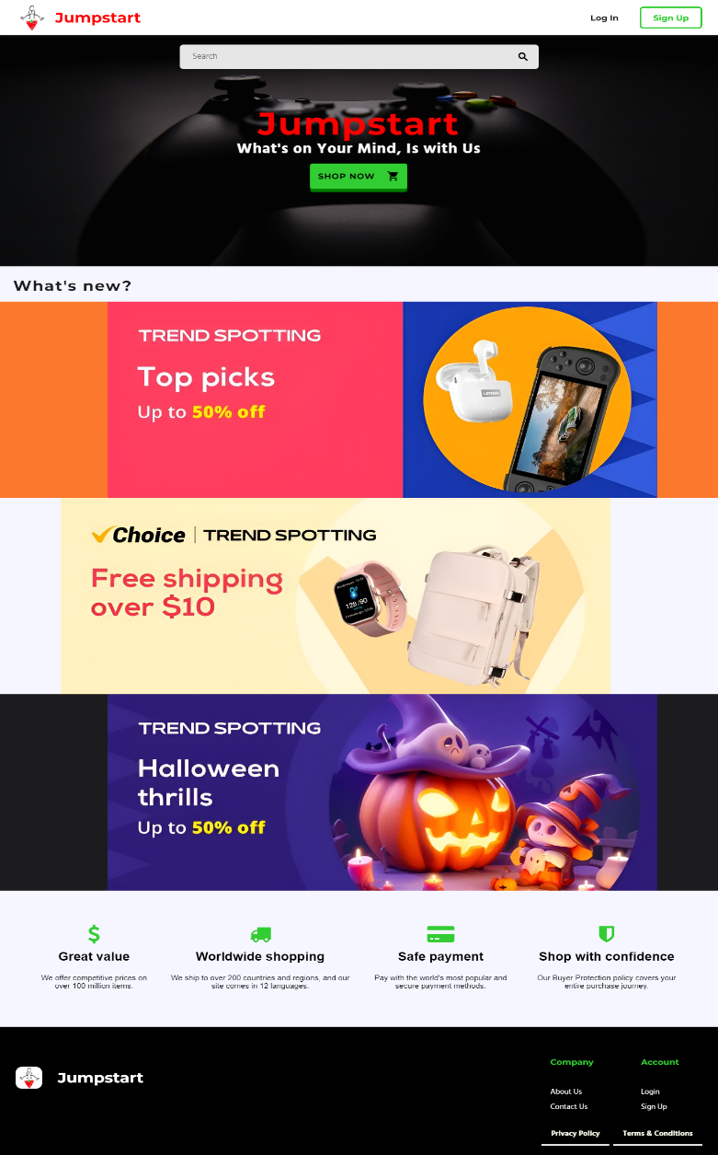
9. Project Execution
Screen Shots of Evidences: website results
Landing Page

Slide 25
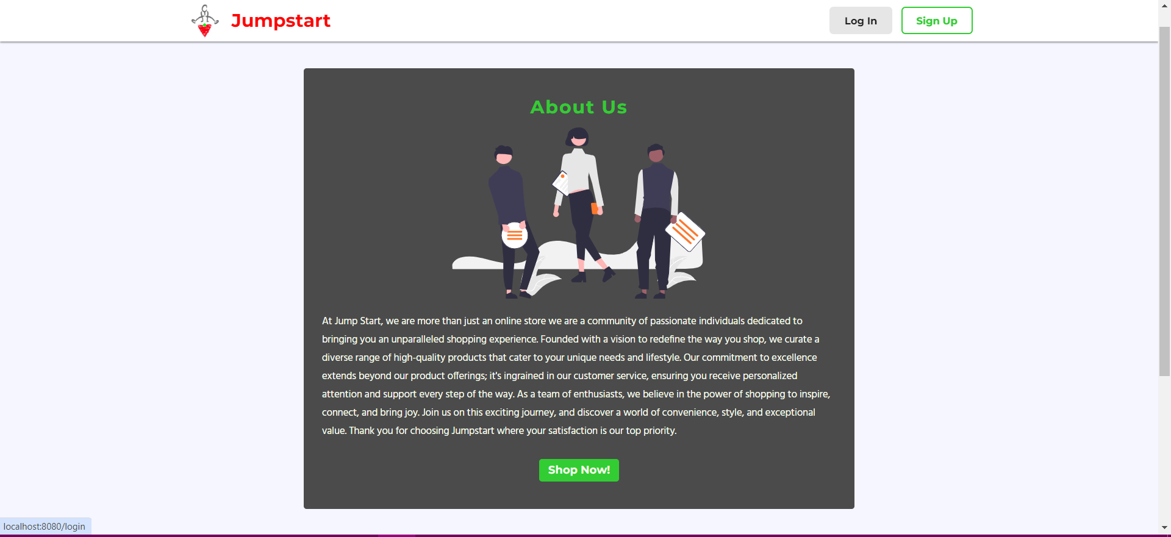
9. Project Execution
About Us Page

Slide 26
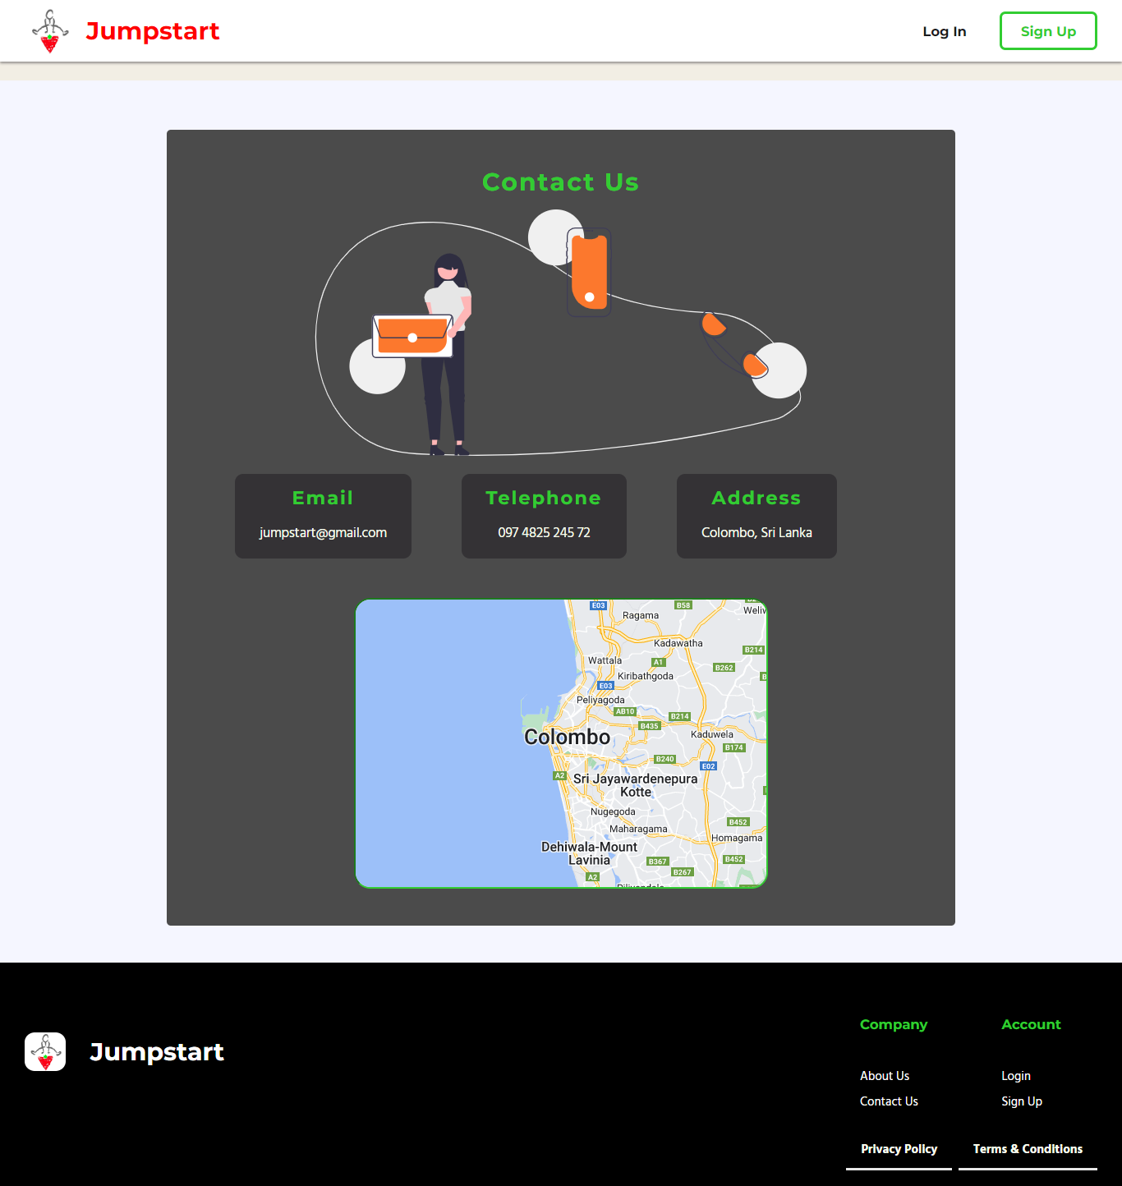
9. Project Execution
Contact Us Page

Slide 27
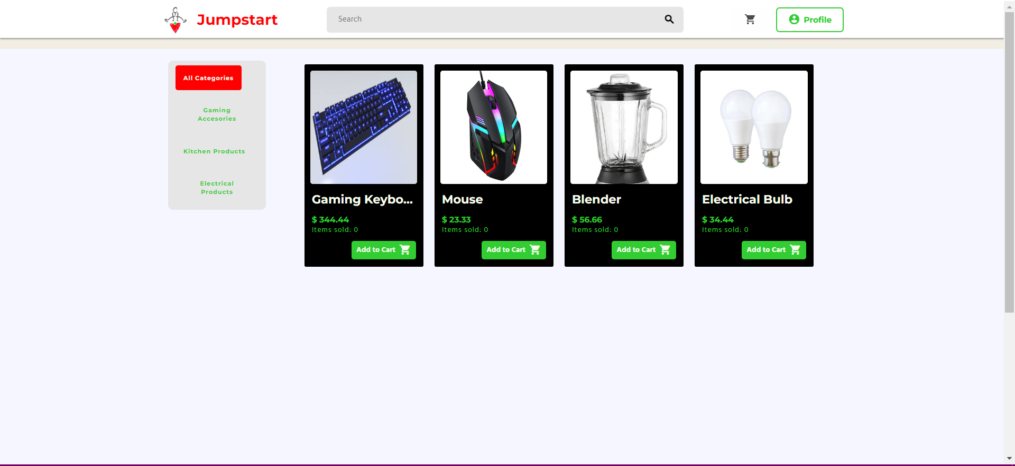
9. Project Execution
Product Page

Slide 28
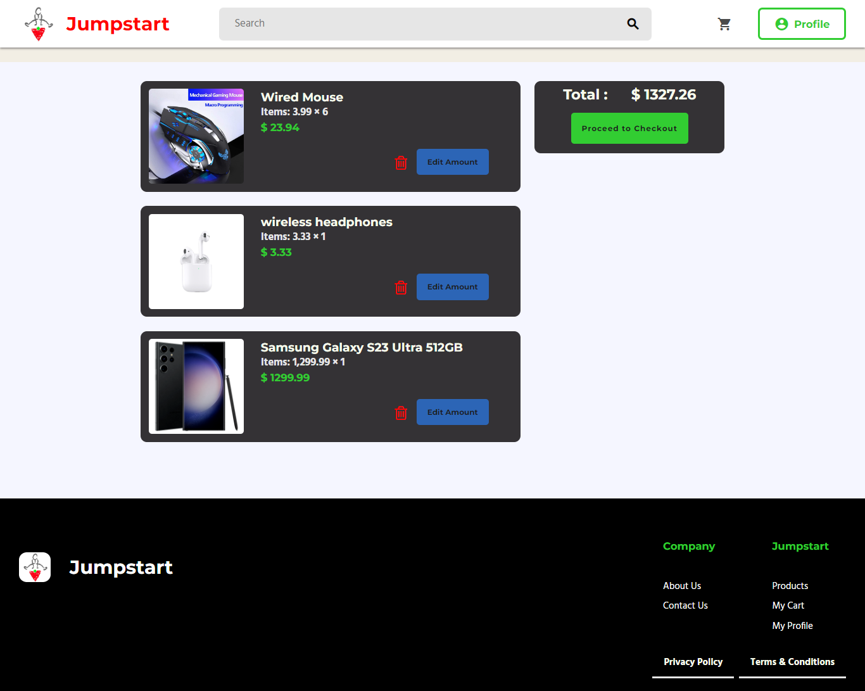
9. Project Execution
Order Product /
Order List

Slide 29
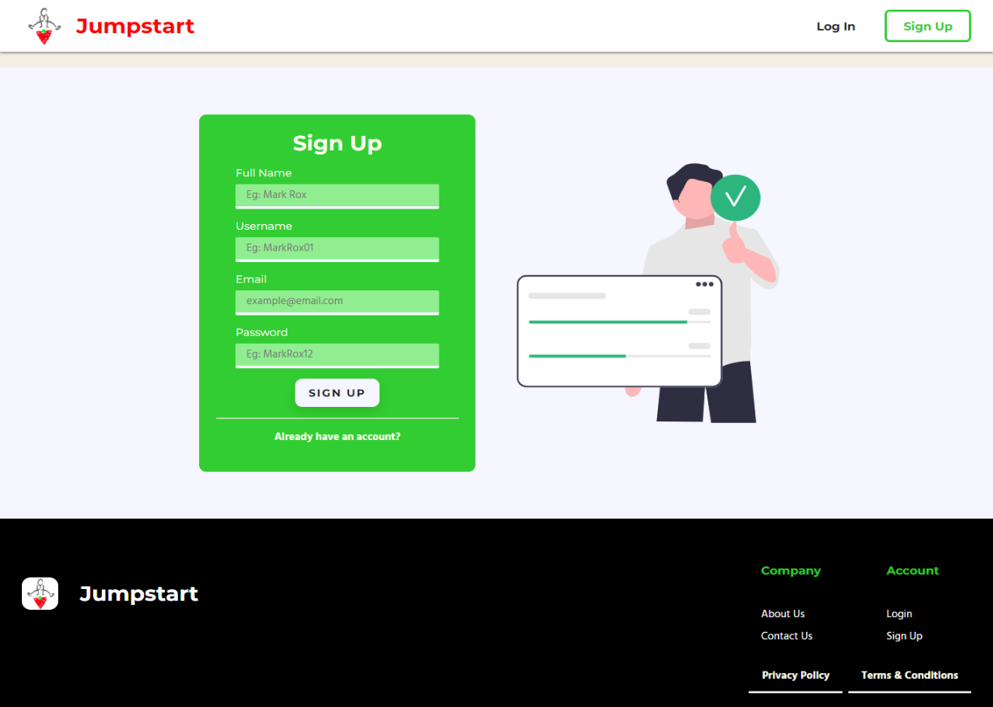
9. Project Execution
Registration Account

Slide 30
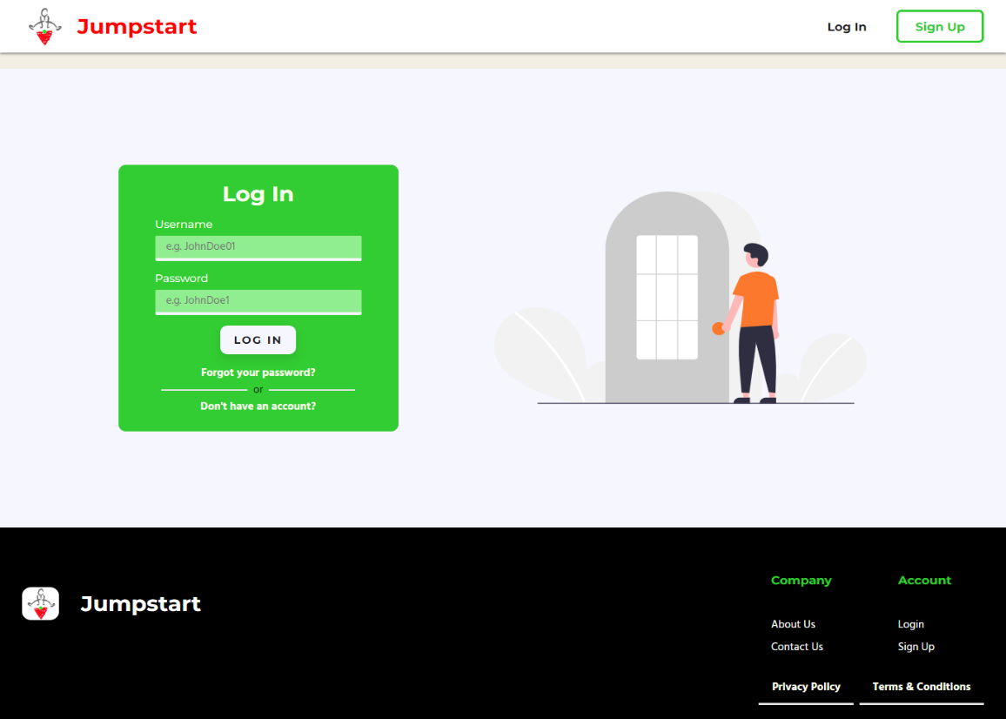
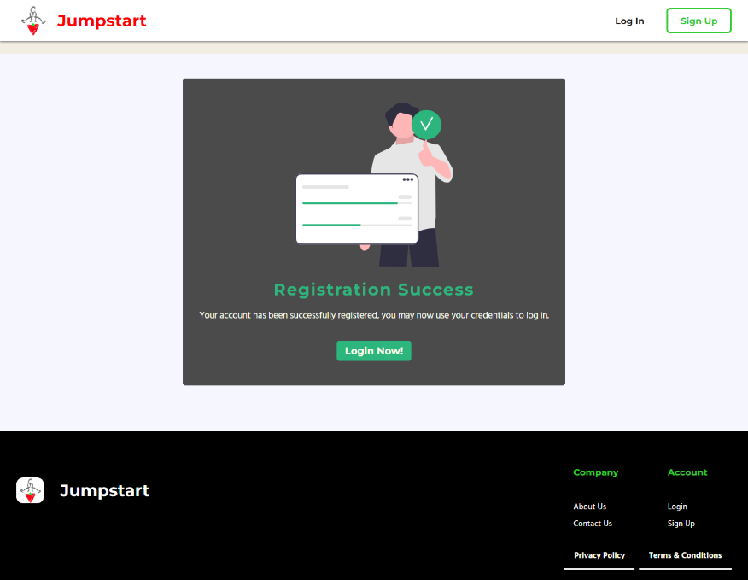
9. Project Execution
Login
Registration Thank You

Slide 31
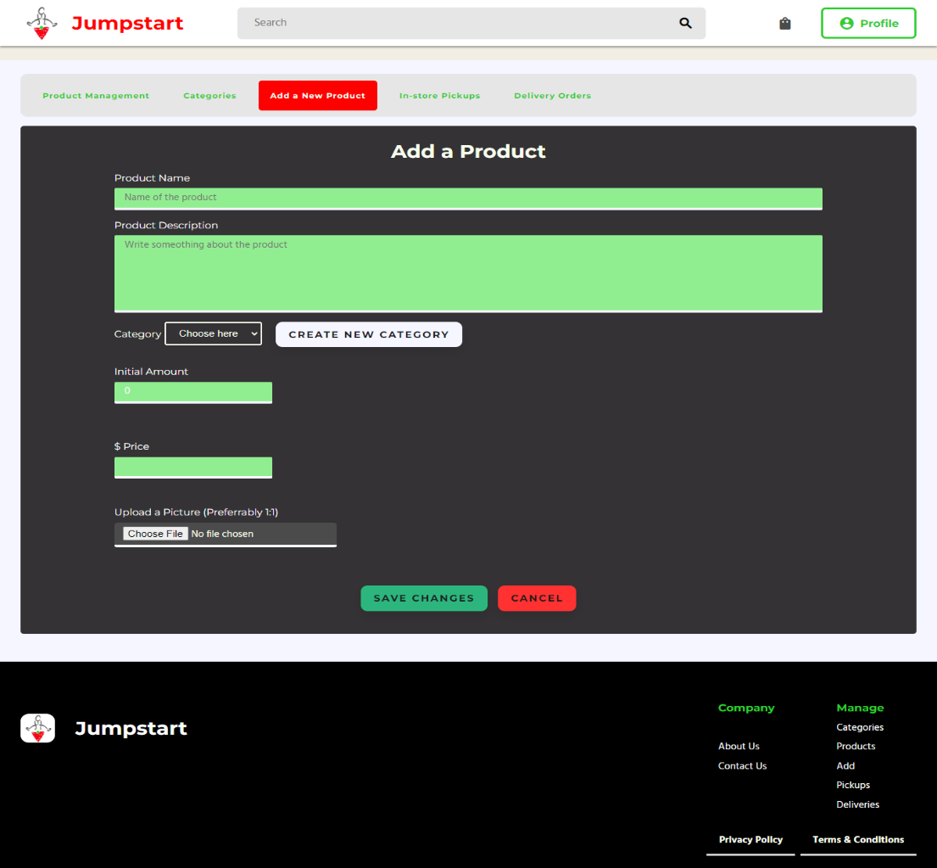
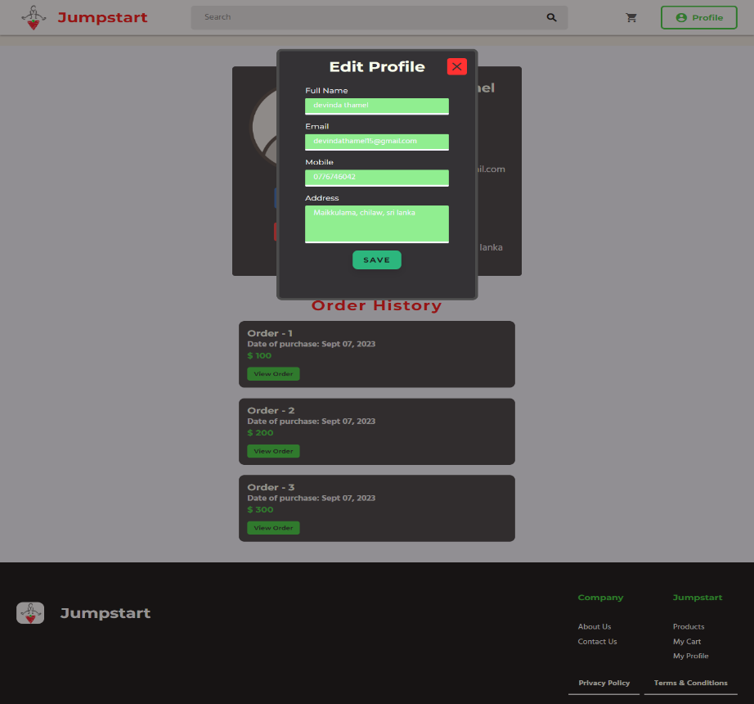
9. Project Execution
Post Products
Edit Profile

Slide 32
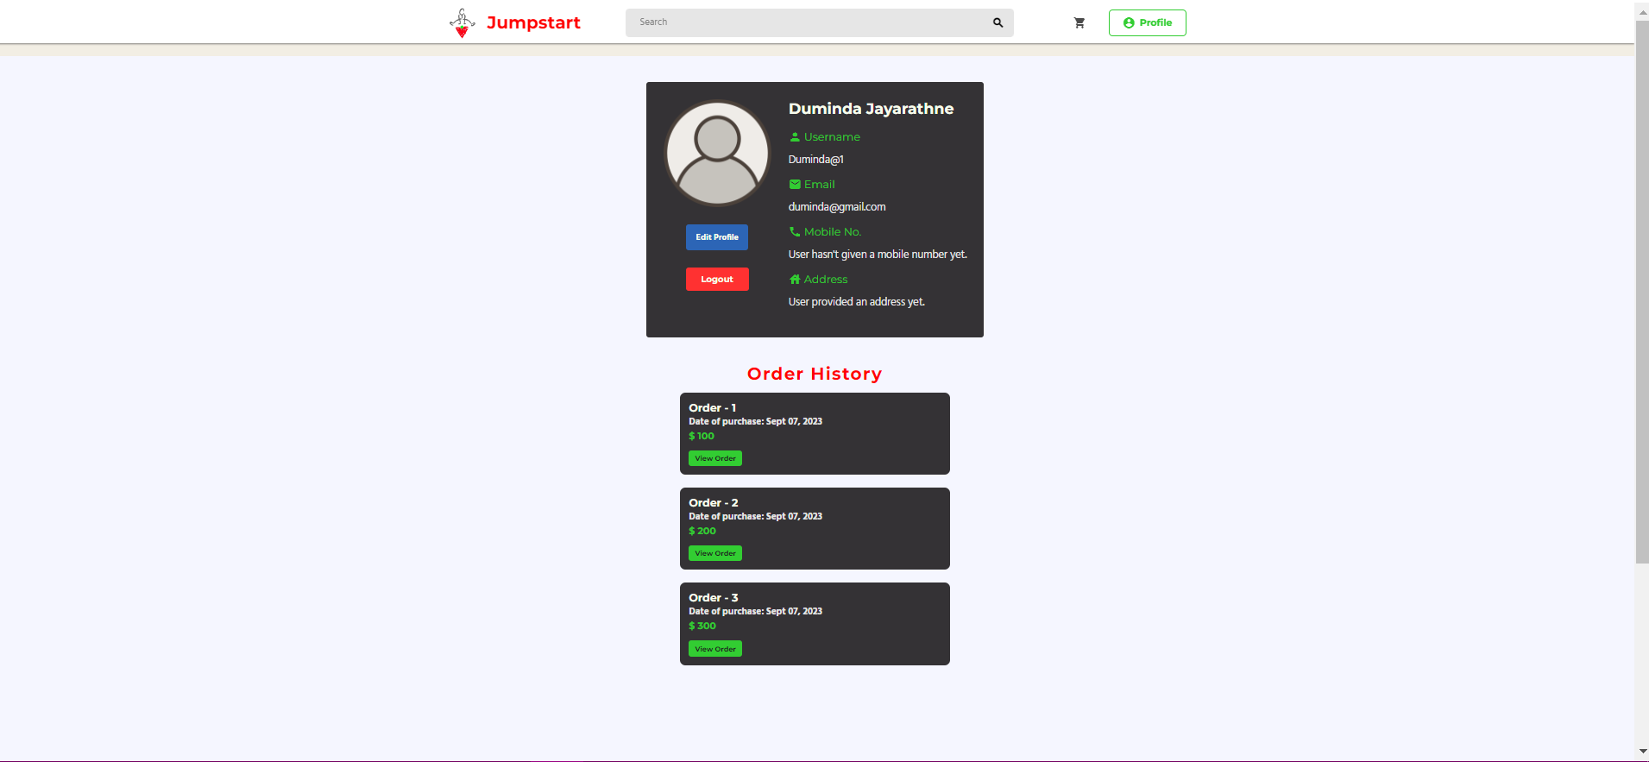
9. Project Execution
Profile

Slide 33
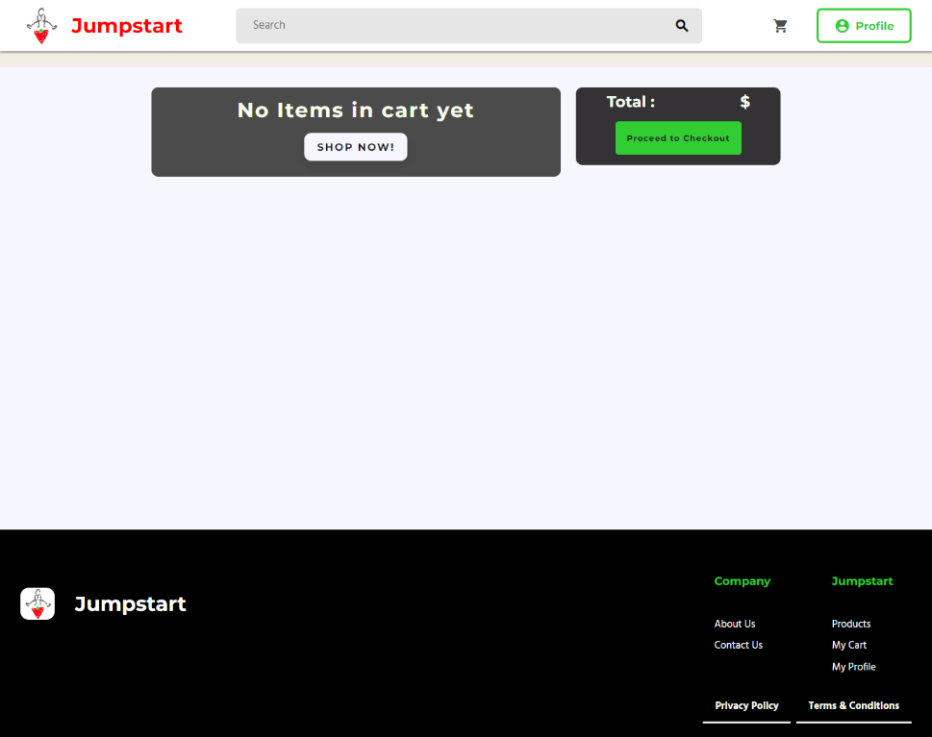
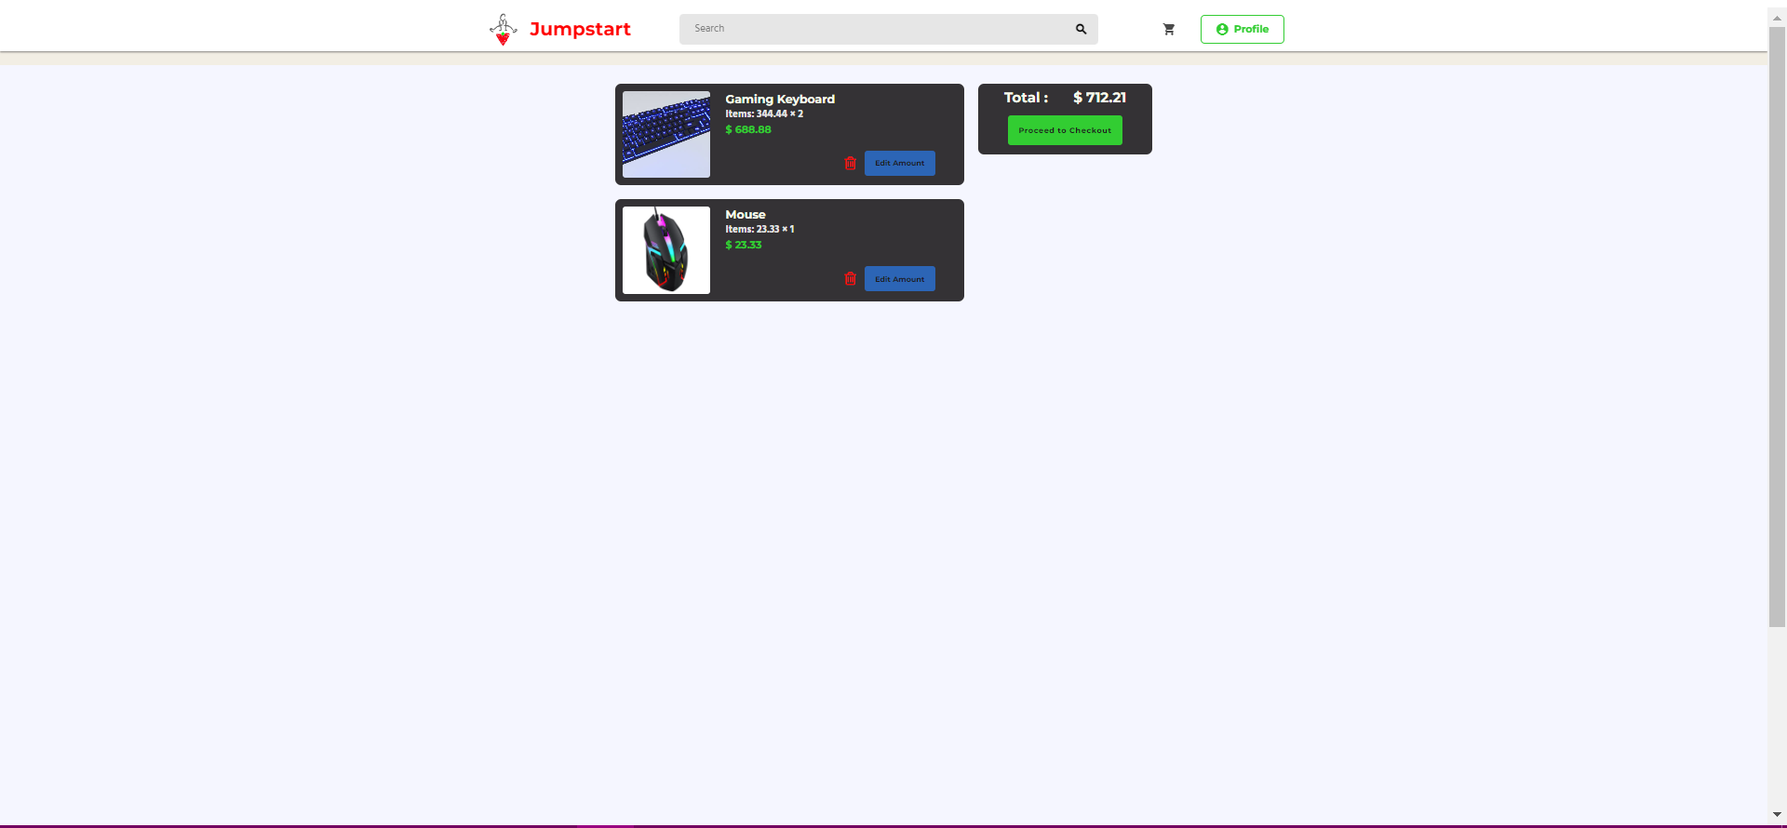
9. Project Execution
Cart Before Add Items
Cart After Add Items

Slide 34
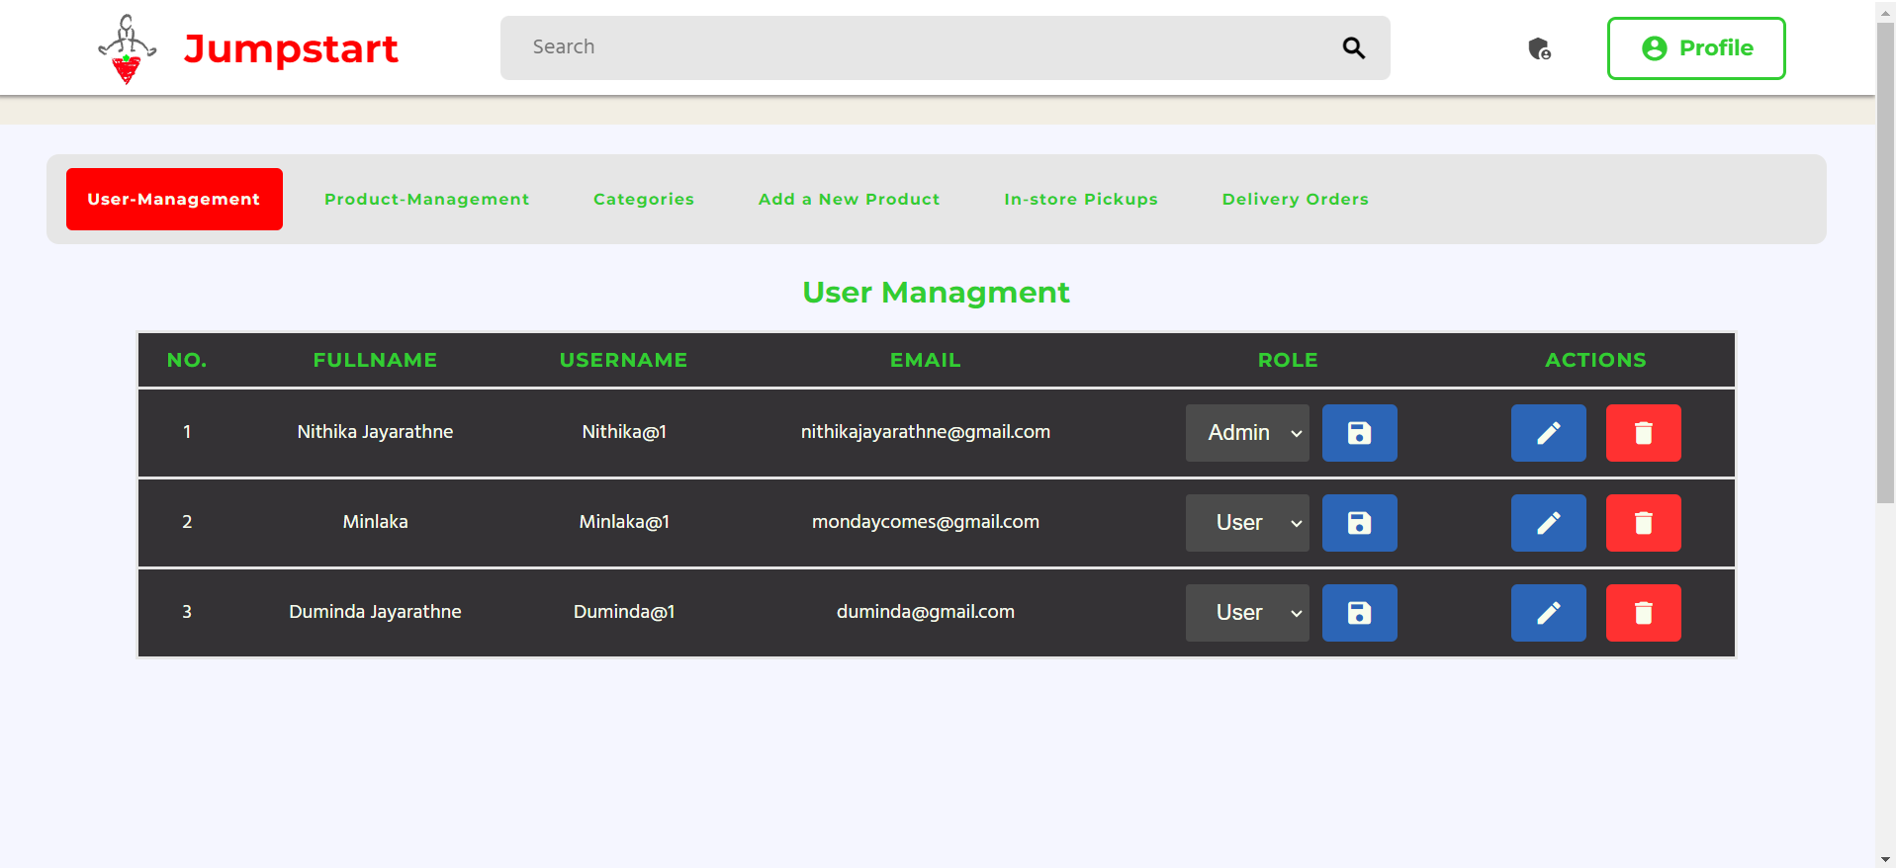
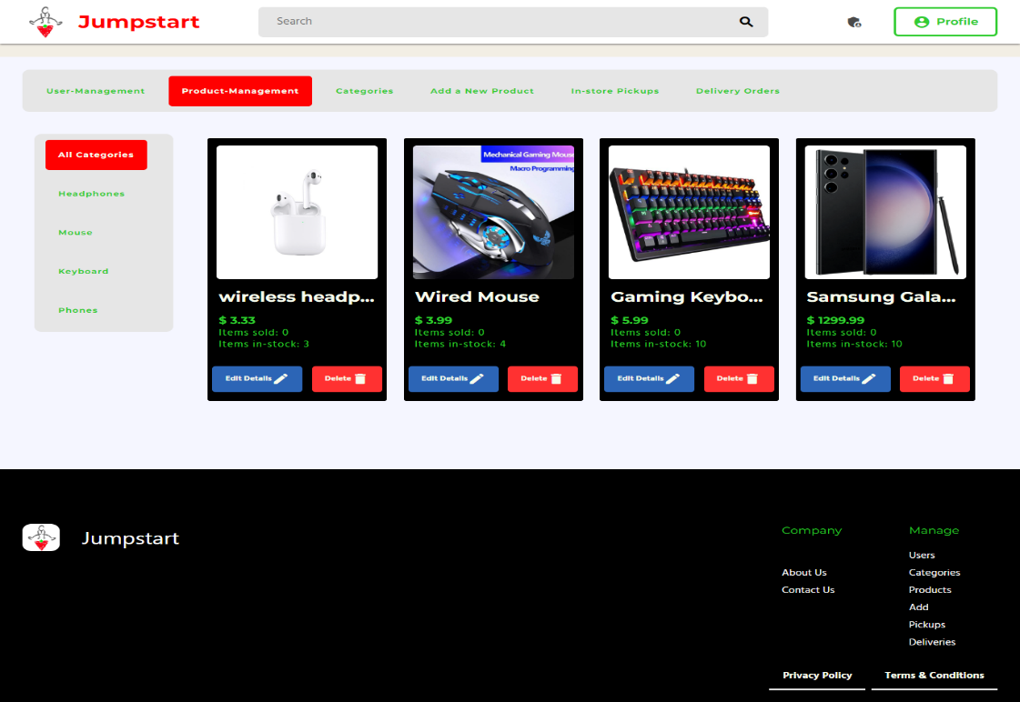
9. Project Execution
Admin Dashboard
Product Management

Slide 35
10. Milestone Feedback & Action taken
Project Milestone ID | Milestone Feedback received from Tutor / Learning Facilitator | Action Taken (Yes / No)
1 | Create survey | Yes
 | Change time periods of Gantt chart | Yes
 | Create product management list | Yes
2 | Add location to contact us page | Yes
 | Add more details to home page | Yes
 | Connect Database | Yes
3 |  | Yes
 |  | Yes
 |  | Yes

Slide 36
11. Proposed Improvements
Future Recommendation
Implement other functionalities
Create chat feature with the partner and the user to get delivery, items condition details
Multiple Payment Facilities
Allow users to create accounts to track orders, save favorites, and manage their information.
Support multiple currencies and handle taxes appropriately based on the customer's location.
Ensure the site is optimized for mobile devices. Many users shop from smartphones and tablets.

